Slide 1
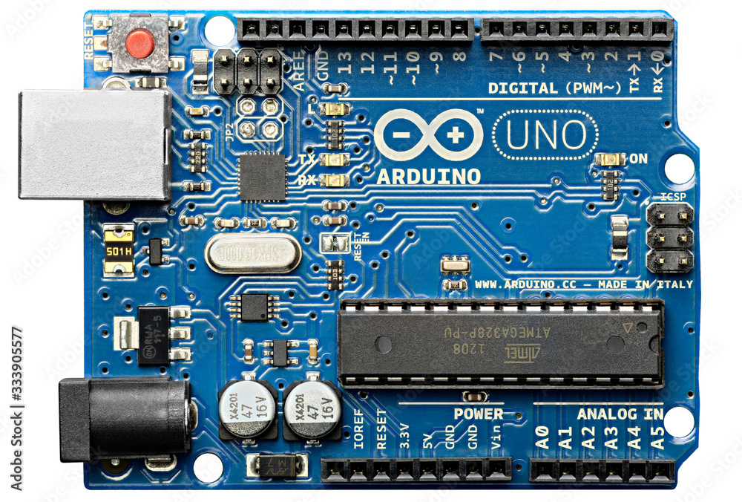
Alexa campataible smart plug
Instrument required for making smart plug
Arduino board
It is an open hardware development board that can be used by tinkeres,hobbyists,and amkers to design and build devices that INTERACT WITH THE REAL WORLD.
it looks like this

Slide 2
In our project we use this to transfer our code to Arduino board to act like that we want let’s talk about some importants part of our Arduino board 1. microcontroller Arduino microcontroller are pre programmed with a bootloader that simplies the uploading of programs to the on-chip flash memory.the default bootloader of the Arduino uno is the optiboot bootloader.boards are loader with program code via a serial connection to another computer

